Slide 1
HOSTEL MANAGEMENT SYSTEM
COMPUTER SCIENCE DEPARTMENT
TEAM MEMBERS
AASHIGAA.C
DHARSHINI.R

Slide 2
HOSTEL MANAGEMENT SYSTEM
Hostel management system which used to store the details of the students who stay in hostels.
Students details would be taken and stored in the database.
It is used to manage the hostel activites.

Slide 3
MODULES
It is easy for admin to manage the students details.
Modules that were used:
Add students.
Display students
Search students
Update students
Delete students
Exit

Slide 4
FUNCTIONS
Fseek - used to move or change the position of the file pointer, to a specified offset position.
FILE*file - use a structure pointer of a file type to declare a file.
Fclose – used to closes a stream pointed. This function deletes all buffers that are associated with the stream before closing it.
Remove – used to delete a given file, pathname pointed to by path.
Rename - used to rename a file.

Slide 5
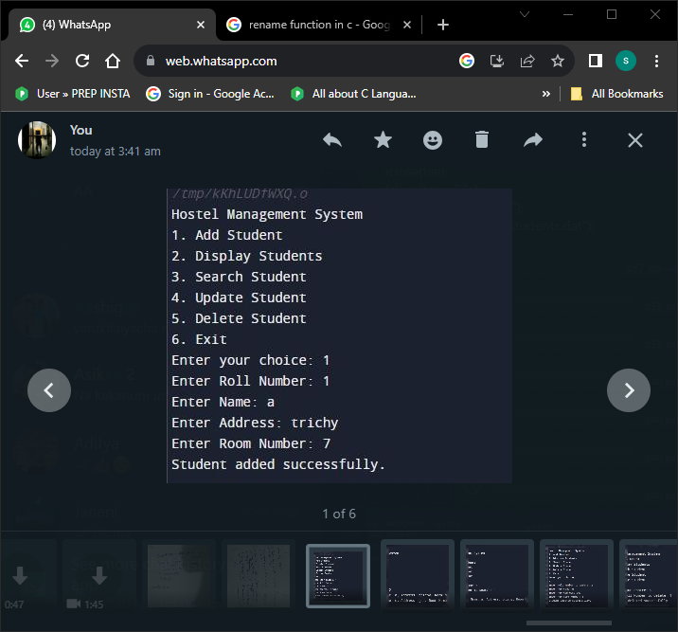
INSERTING STUDENTS DETAILS

Slide 6
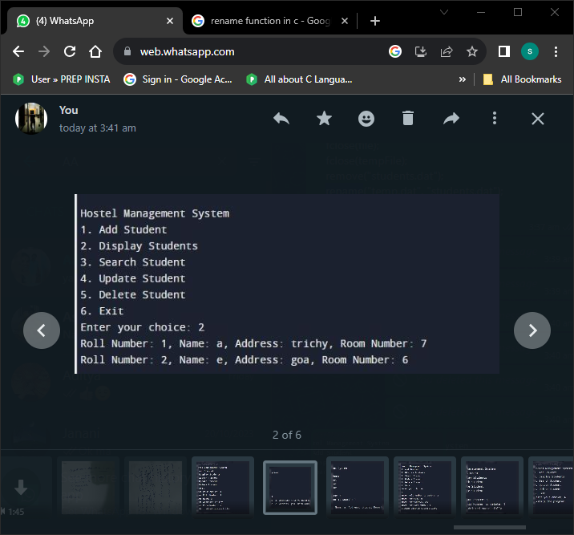
DISPLAYING THE DETAILS

Slide 7
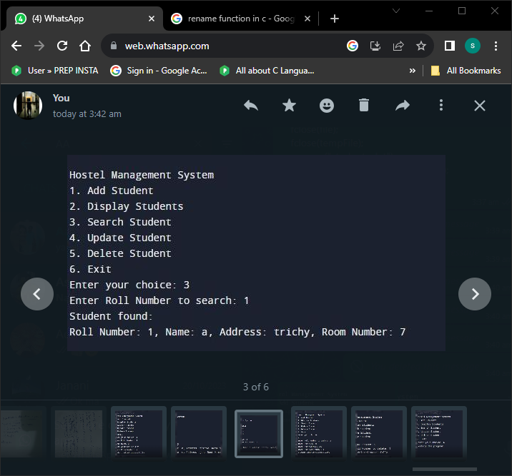
SEARCHING

Slide 8
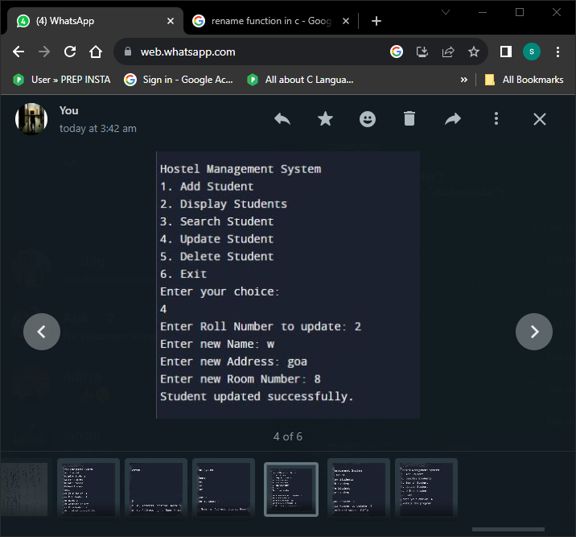
UPDATION OF STUDENTS DETAILS

Slide 9
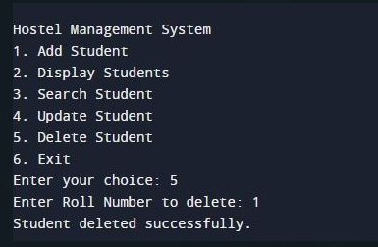
DELETION OF STUDENTS DETAILS

Slide 10
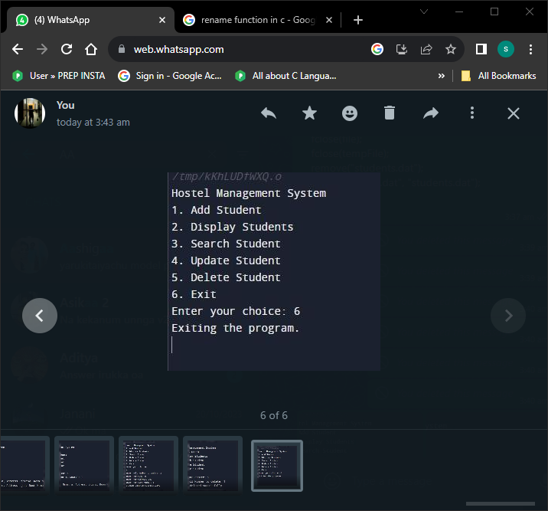
EXITING FROM THE PROGRAM

Slide 11
THANK YOU

